Slide 1

Thoughtful
An extensible toolbox structured to guard human thinking
Ken Arnold | Calvin University | 2026-11-02
with: Nhyira Mante, Jiamei (Mary) Chen, and Alvin Waigwa

Slide 2
“Slop” is a Systemic Problem
“Use AI responsibly” puts the burden on the individual writer.
  (…and the individual student.)
How can we design tools that make responsible use easier?
  (… without being annoying?)

Slide 3
We must design what AI should not do.

Slide 4
Fences in Writing
Affordances: Interaction-Required Suggestions
Roles: “Imagine questions a reader might have”, etc.
Prompts: “Non-directive coaching; don’t provide words”
  LLMs are getting better at obeying prompted limits, but not perfect
Harnesses
  Deterministic rules: edits must use only the writer’s own words
  Classifier-enforced rules: like Auto Mode but for writing

Slide 5
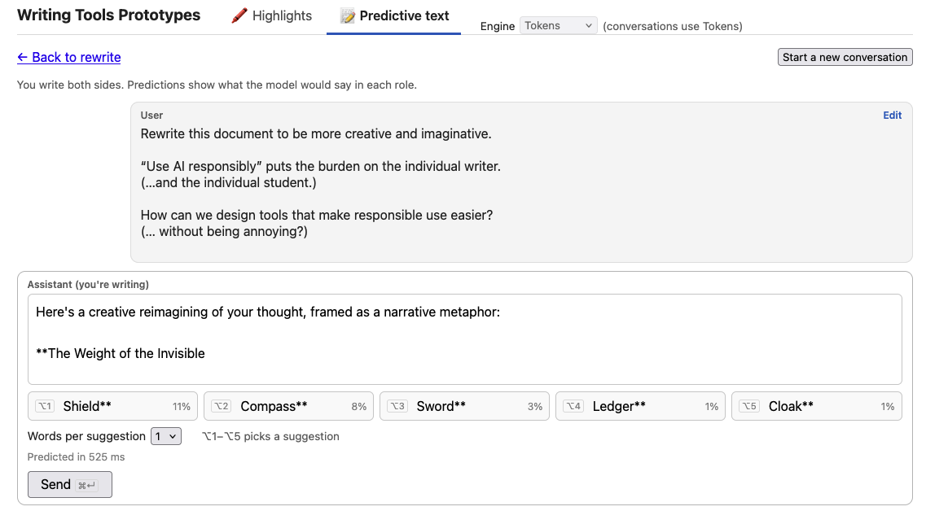

Slide 6
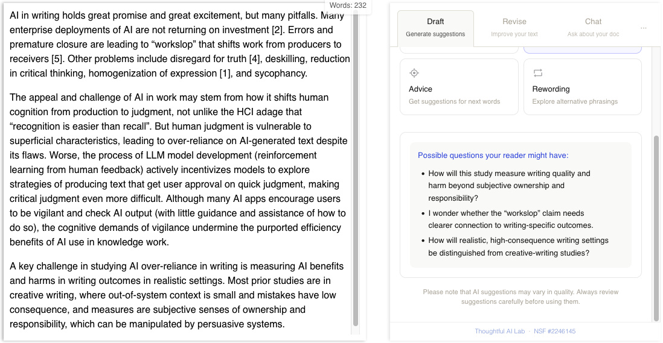

Slide 7
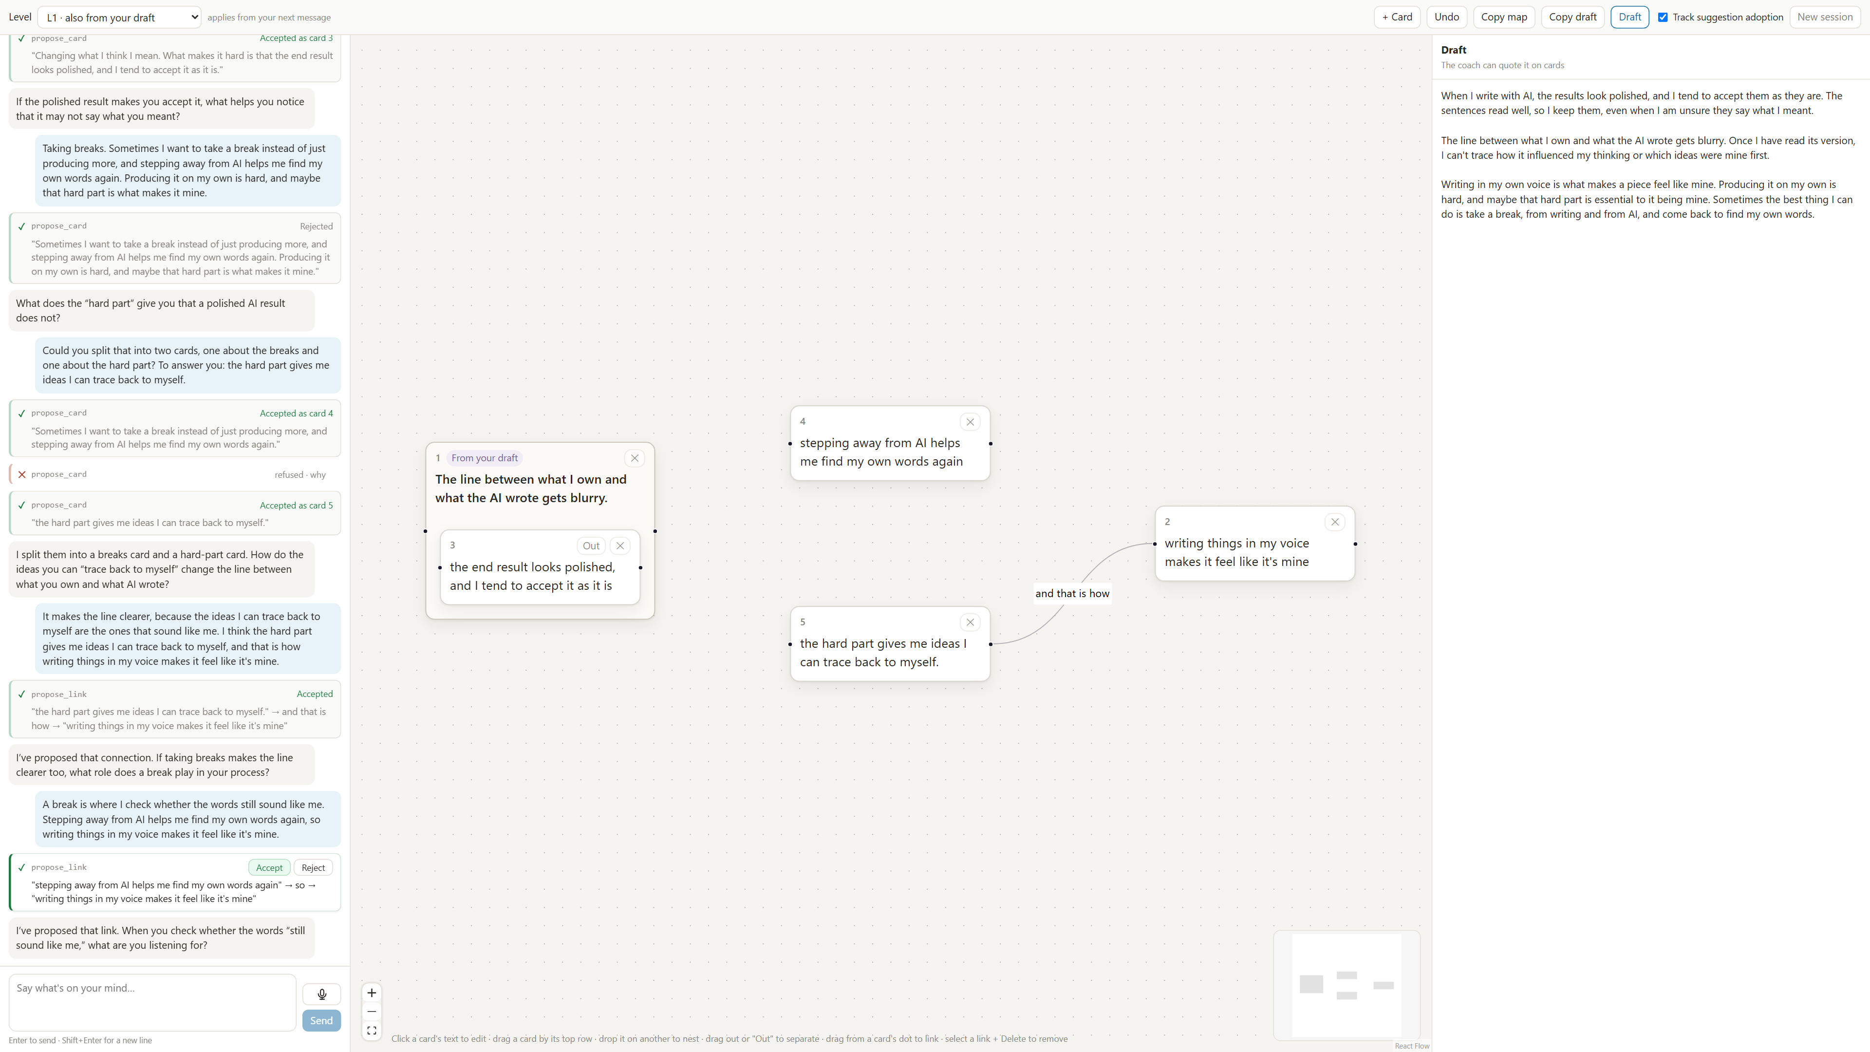

Slide 8
Harness Rules for Writing
Even with frontier models, Claude Code still needs approval rules and classifiers. Writing tools need guardrails at least that strong!
Our rule: edits must use only the writer’s own words
Context
draft + “Use only my words”
asked, not enforced
Fence: rejects edits that aren’t your words
enforced
Model
Reads text,
writes text
Harness
Builds the context,
checks the request,
performs the action
Your
document
“Replace ¶2 with: …”
A request, not an action
Notes:
e.g., Auto mode

Slide 9
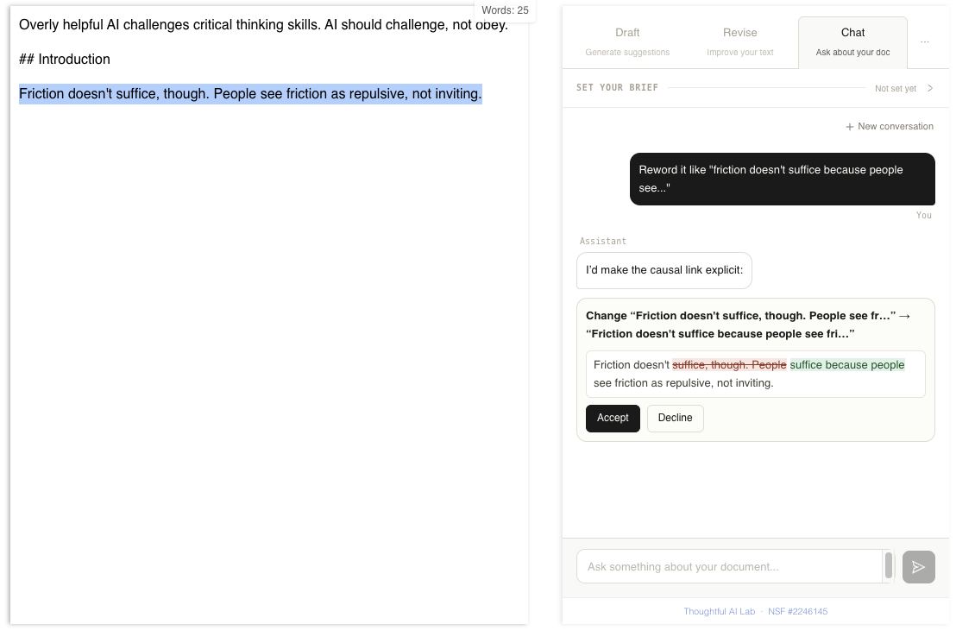

Slide 10
Good Fences Make Good Neighbors
Affordances: Interaction-Required Suggestions
Roles: “Imagine questions a reader might have”, etc.
Prompts: “Non-directive coaching; don’t provide words”
  LLMs are getting better at obeying prompted limits, but not perfect
Harnesses
  Deterministic rules: edits must use only the writer’s own words
  Classifier-enforced rules: like Auto Mode but for writing

Slide 11
A Thoughtful Platform

Slide 12
Editor-Integrated Tools
We make prototypes as web apps…
But people write inside MS Word, Google Docs, Outlook, etc.
Extensible platforms, but requires:
  App store approvals
  LLM access management
  Logging and consent (for studies)
Could you vibe-code a Word add-in?

Slide 13
A Thoughtful Platform
My students have been working on the software engineering for years. You can build on our work.
Two paths:
No-code extensibility via prompt packs (buttons, chat personas)
Serverless apps via OAuth

Slide 14
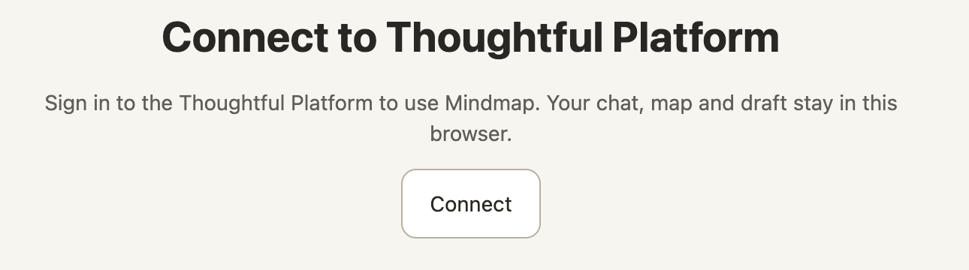
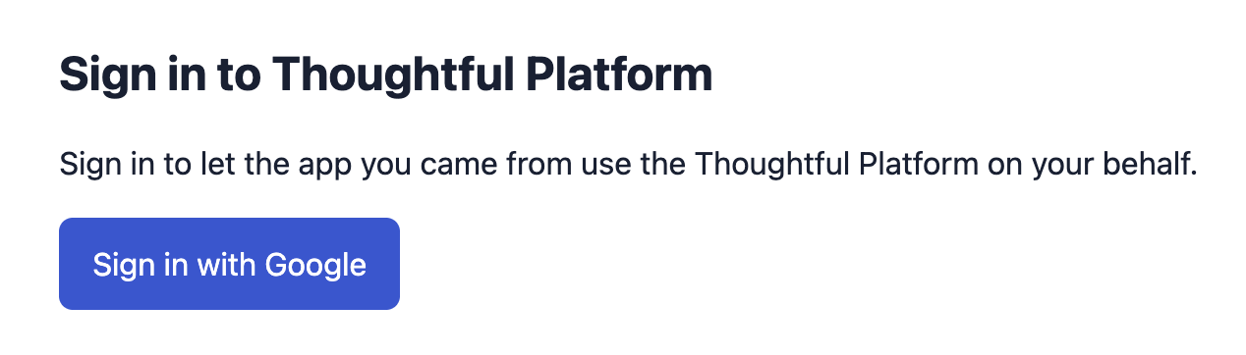
https://mindmap.thoughtful-ai.com/
(GitHub Pages static site)
app.thoughtful-ai.com/api/oauth/login?response_type=code&redirect_uri=https…

Slide 15
Thoughtful Platform Provides
(or will soon…)
Account management (via, e.g., Google federated login)
LLM access and billing
  We’re footing the OpenAI bill for now.
  Future: connect OpenRouter or local models
Accessing the document in Word / Google Docs
  Read: Markdown snapshot, cursor position, other tab content
  Highlight: scroll the document to highlight a phrase (e.g., “Where should I work next?”)
  Edit with fences, e.g., the own-words constraint

Slide 16
How you can build on Thoughtful
Point your agent at our API spec
You don’t need our approval to make a prototype
  Each existing user can host a client grant
For studies / deploying your tools: talk with us

Slide 17
Some Provocations
Develop tools for communities that write.
  “Every one of the nineteen concepts has exactly one human in it.” [Claude, discussing design ideas in our repo]
  Success might mean taking a walk with a person.
Design for boundaries; let the AI companies tackle capabilities.
  Requiring interaction; fencing edit actions; specifying roles
Design measures beyond narrow session success:
  how writers learn, reflect, synthesize
  how using AI forms writers’ skills, habits, dispositions
  how AI shapes communities
kenarnold.org/in2writing26
Notes:
AI resilience / self-efficacy?

